Slide 1

Enterprise Software Development
Notes:
TODO: add on slide title 1.2

Slide 2
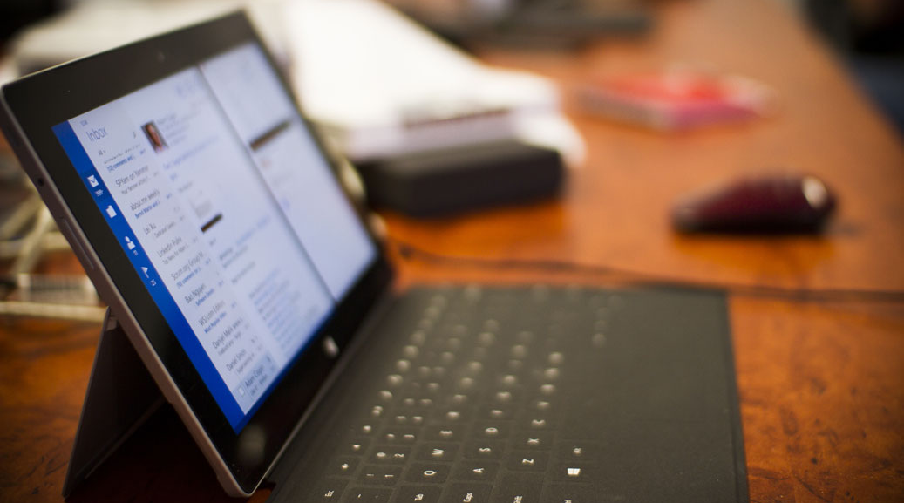
Angular Resources
Angular Super Powers Tour
Notes:
I wish I had been given this talk

Slide 3
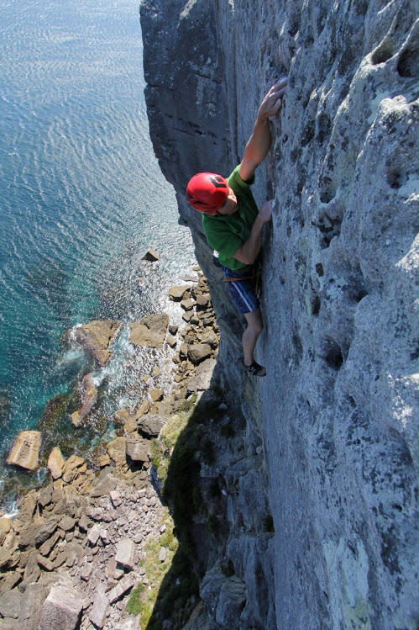
Duncan Hunter
@DuncHunter
Software Architect
Focus on Angular and TypeScript
Rock climber
Notes:
Spend the most of my time building ng and ts
This is actually me in Jervis Bay south of Sydney
Follow me on twitter

Slide 4

Agenda
1. What are our favourite resources
Notes:
Approx. 45min for the 10 qu and the Q&A

Slide 5


Slide 6
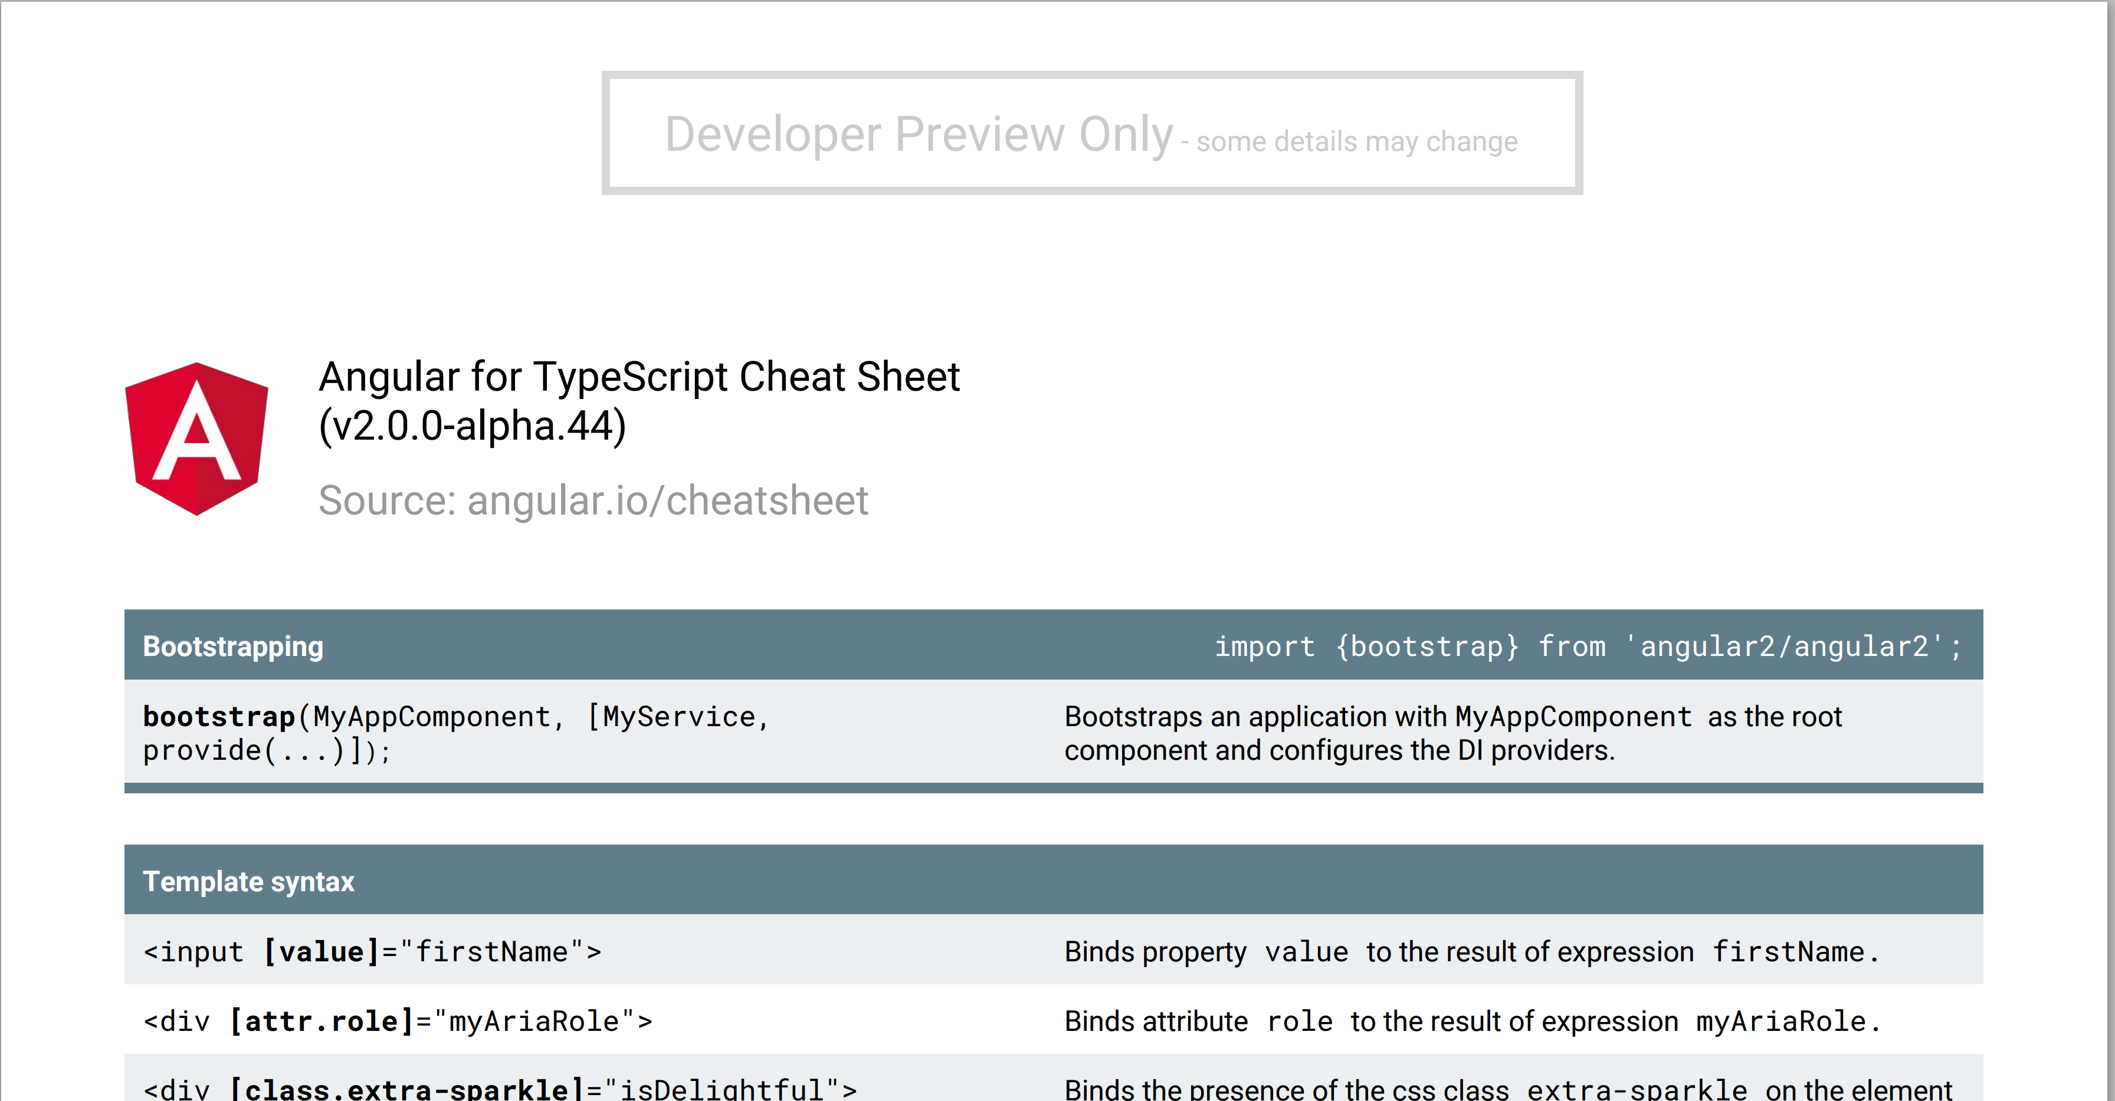

Slide 7
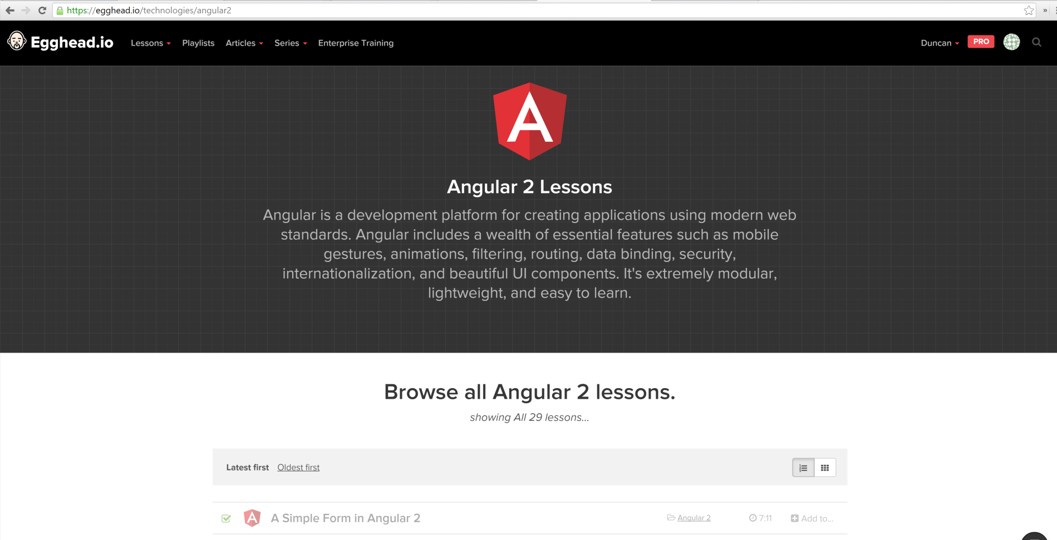

Slide 8


Slide 9
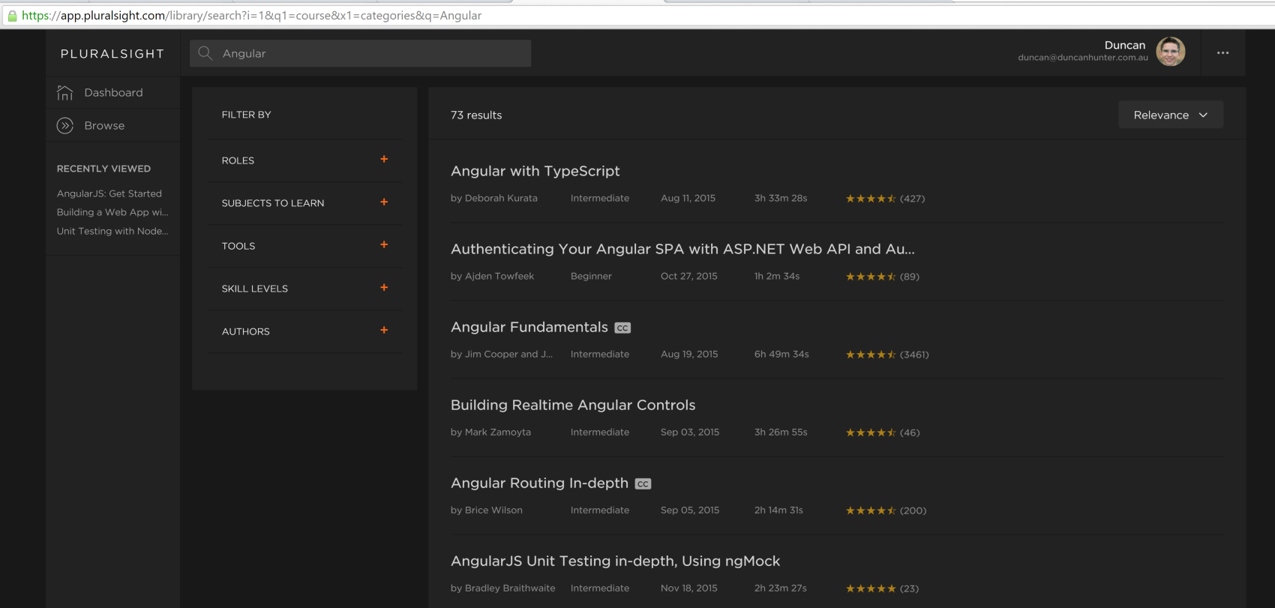

Slide 10
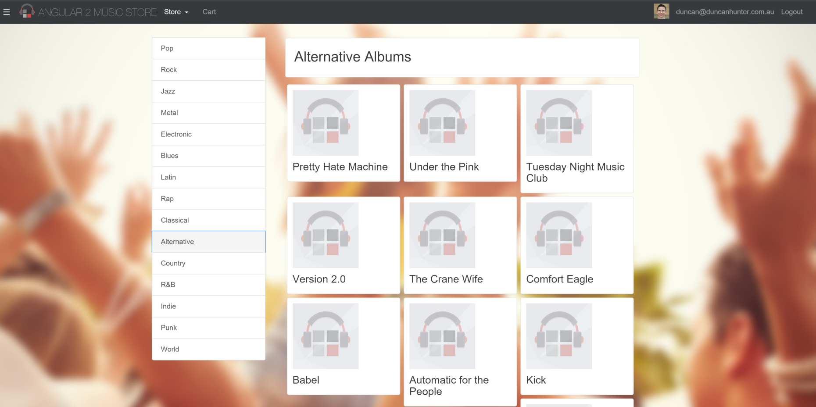

Slide 11


Slide 12
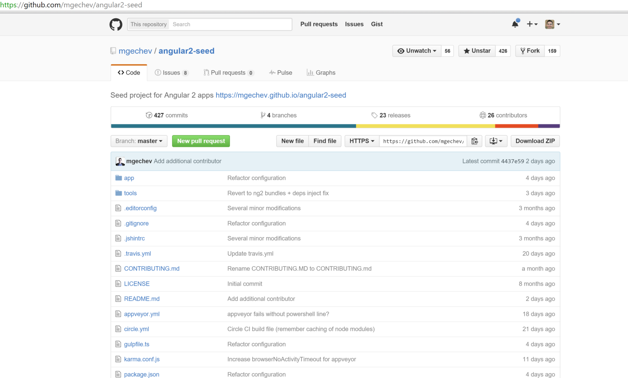

Slide 13
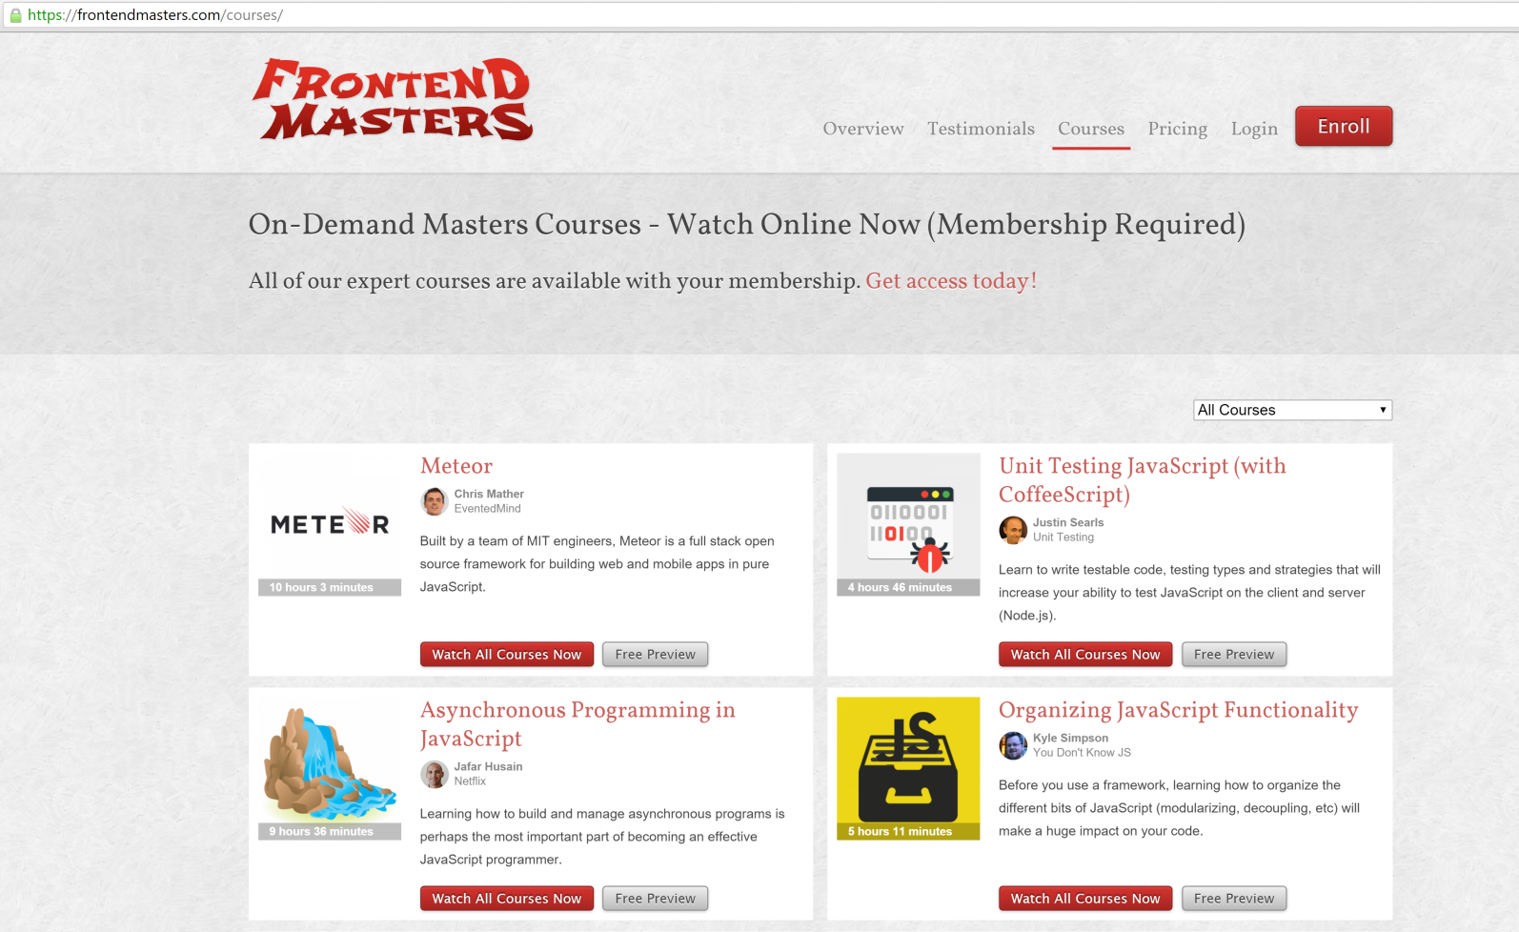

Slide 14
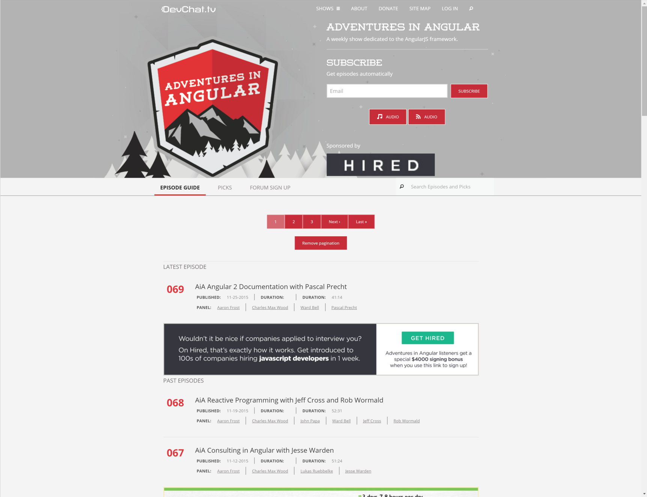

Slide 15
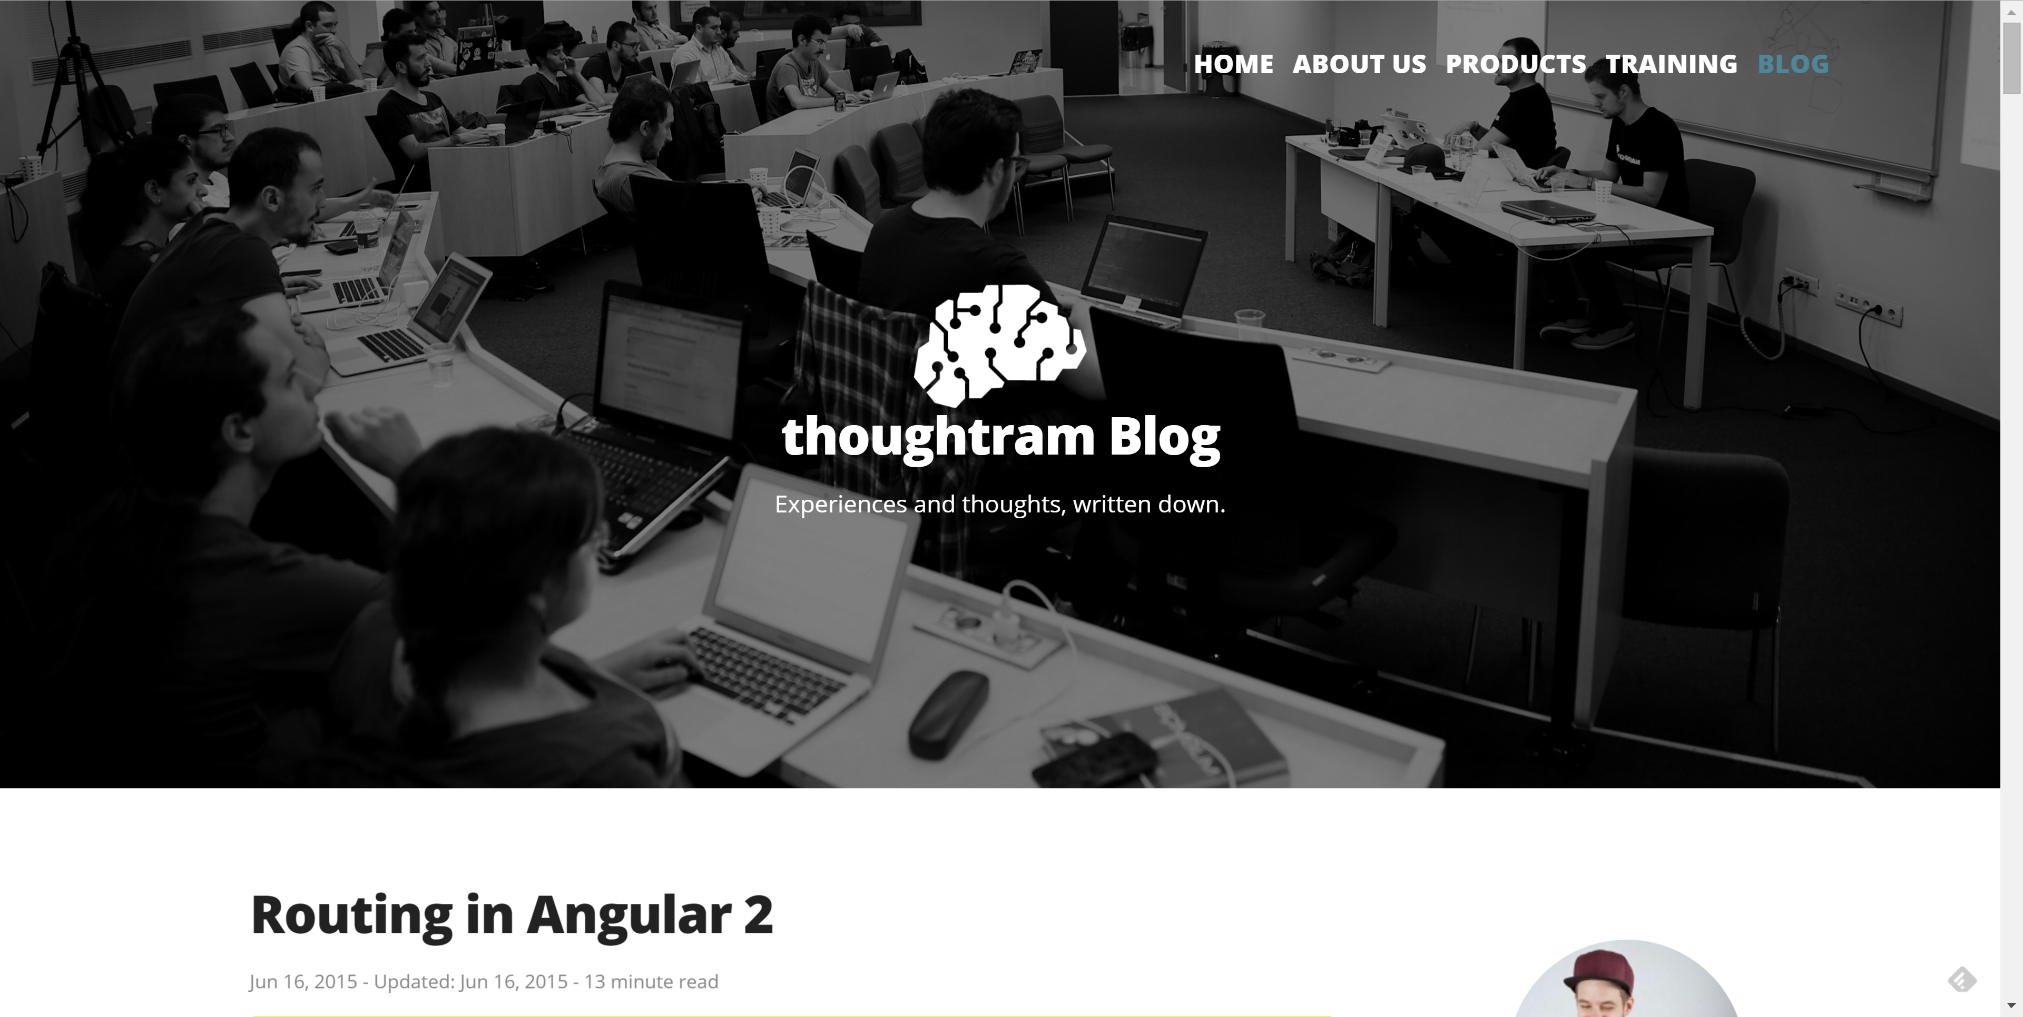

Slide 16
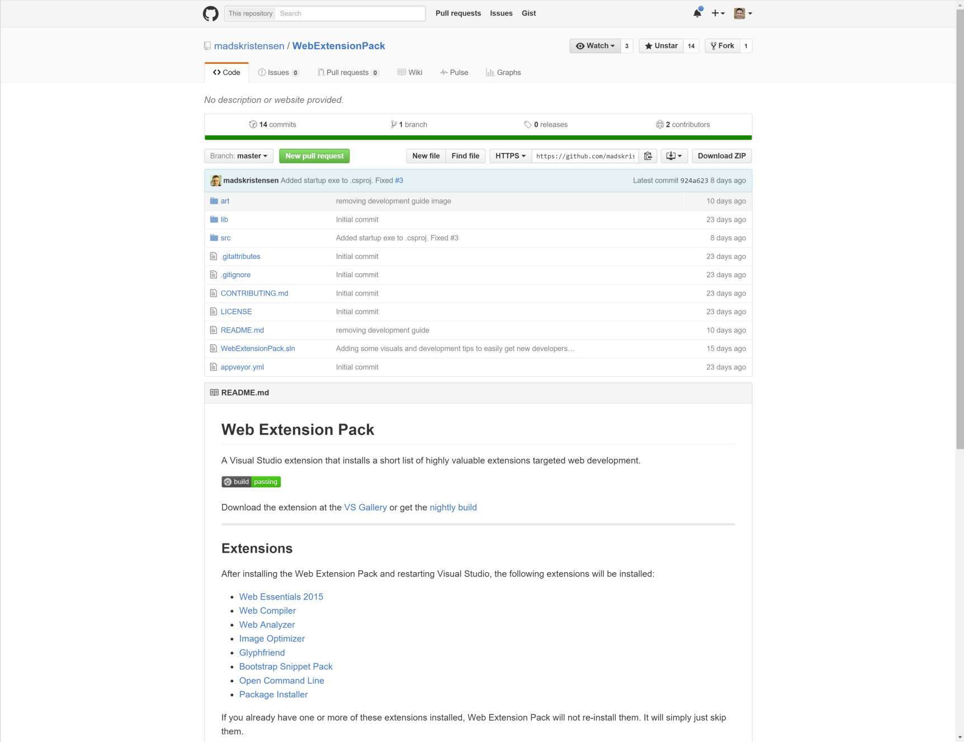

Slide 17
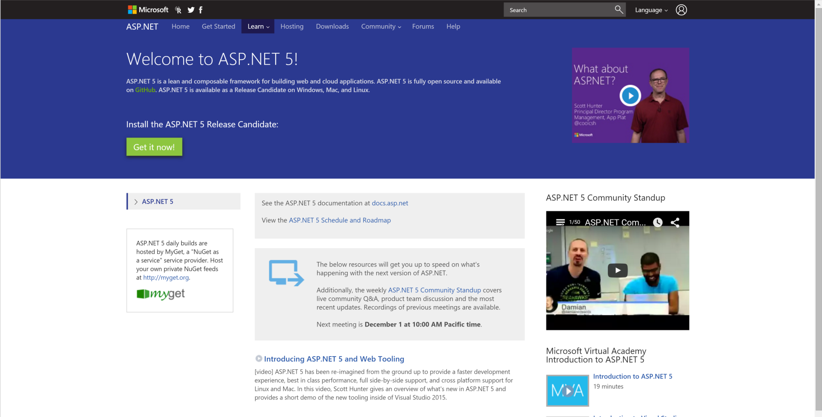

Slide 18
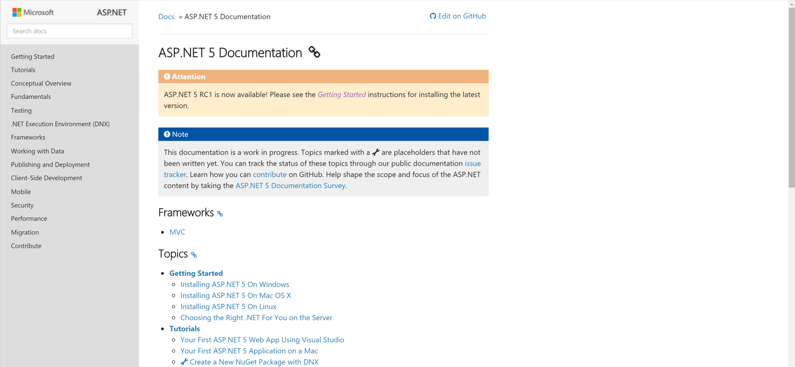

Slide 19
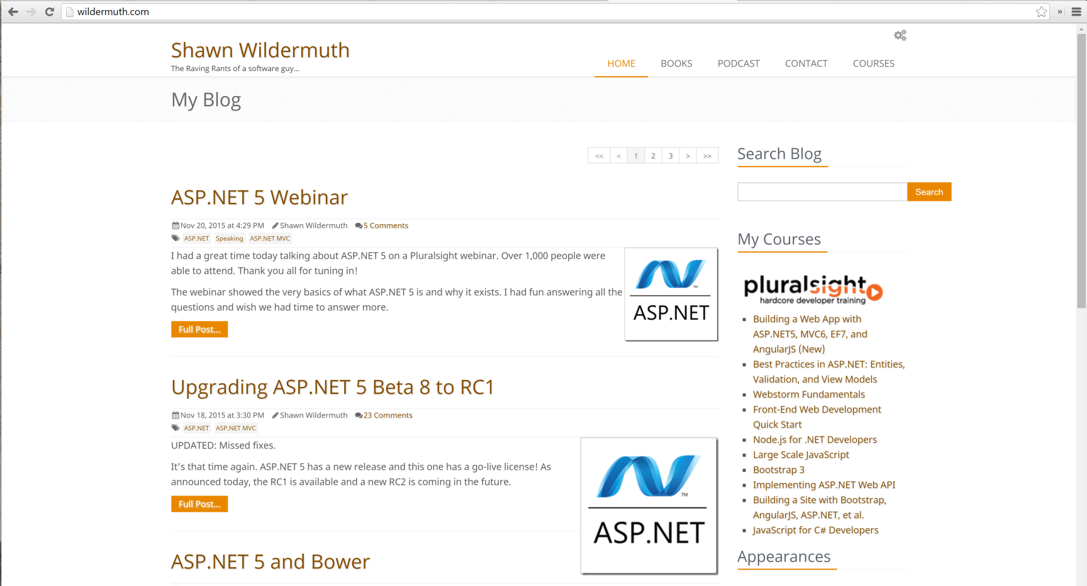

Slide 20


Slide 21


Slide 22


Slide 23


Slide 24
Summary
1 Our favourite resources
Notes:
NOTE agenda same as finish
Approx. 45min for the 10 qu and the Q&A

Slide 25
Thank you! info@ssw.com.au www.ssw.com.au Sydney | Melbourne | Brisbane | Adelaide

